Slide 1

Sexism Identification
Text Mining and Sentiment Analysis
Luca Graziano

Slide 2
TABLE OF CONTENTS
01
GOAL
04
MODELING SETUP
Introduction to the analysis, its purpose and results achieved
Description of the modeling problem and of the chosen evaluation metric
02
DATASET
05
MODELS
Description of the data that has been used
Description of the models that have been used and of their results
03
DATA PRE-PROCESSING
06
LANGUAGE COMPARISON
Description of all pre-processing operations
Wordcloud comparison of Italian and English sexist language

Slide 3

SEXISM IDENTIFICATION
01
Sexism is any discrimination against people on the basis of sex. Detecting online sexism especially on social media can be difficult due to the volume of comments as well as the variety of forms in which it is expressed.
Automating sexism identification requiers the use of machine learning models.

Slide 4
The analysis resulted in the development of both simple and more complex models with the final model reaching nearly 70% in the chosen evaluation metric
01

Slide 5
DATASET
02
English Dataset
Italian Dataset
Highly unbalanced dataset composed of 13631 tweets labeled as either sexist or non-sexist
Dataset composed of 3922 tweets labeled as either sexist or non-sexist

Slide 6
AUGMENTED DATASET
02
Data augmentation in the form of machine translation has been performed in order to balance out the dataset and achieve higher performance levels. Translation has been done to 5 European languages: Italian, French, Spanish, German and Portoguese

Slide 7

DATA PRE-PROCESSING
03
LINKS REMOVAL
PUNCTUATION REMOVAL
NUMBERS REMOVAL
EXTRA SPACES REMOVAL
MENTIONS REMOVAL
EMOTICONS REMOVAL
HASHTAG REMOVAL
STOPWORDS REMOVAL
LOWERCASE STANDARDISATION

Slide 8
FEATURE ENGINEERING
03
DEEP LEARNING MODELS
MACHINE LEARNING MODELS
Data that has been fed to machine learning models have been word tokenised and then TF-IDF vectorised
Data that has been fed to deep learning models have been word tokenised and then GloVe Vectorised
TF-IDF vectorisation allows for evaluating the relevance of a word in a collection of document considering how frequent it appears in a document and how common it is across documents
However, despite being very cheap, TF-IDF is not able to derive context from words
GloVe vectorisation considers both local and global word statistics, that is taking into account both context words and the data co-occurrence matrix.

Slide 9
MODELING SETUP
04
Addressing class unbalance
Evaluation Metric
Data augmentation
Class weights
The chosen evaluation metric is recall on the positive class as it ensures that the model optimises for identification of sexist comments at the expense of potentially classifying non-sexist comments as sexist
Data augmentation drastically reduced the difference in class distribution
Class weights have been given to models in order to take into account the class distribution across the dataset

Slide 10
MODELS
05
The following are the results of the models trained on the augmeted dataset
Model | Positive Recall
Logistic Regression | 1%
Decision Tree | 3%
Xgboost | 2%
CNN | 69%
BiLSTM | 62%
All models that have been trained on the non-augmented dataset performed really poorly with a maximum positive recall of 19% for the BiLSTM

Slide 11
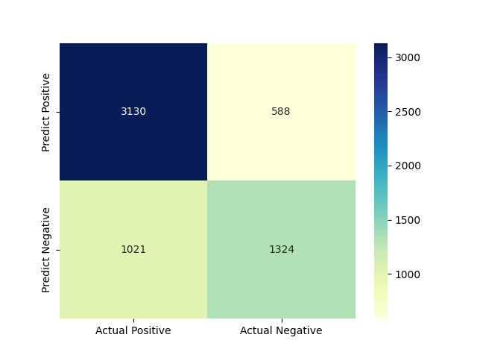
Augmented CNN
05
The CNN is the first deep learning model that has been tested, though is generally used for computer vision tasks rather than text. It was trained using GloVe word embeddings and class weights based on the distribution.
It achieved a 69% recall on the sexist class

Slide 12
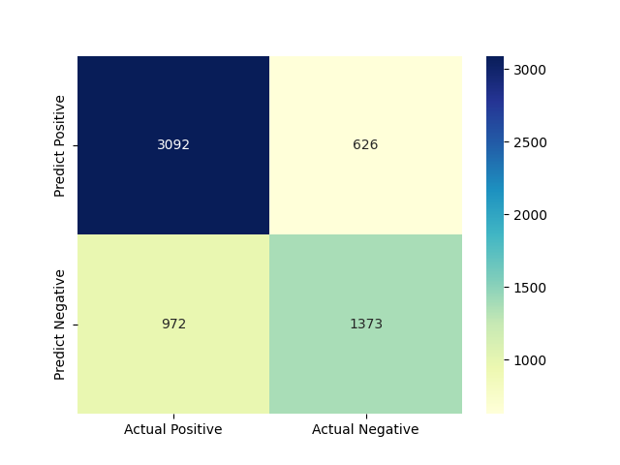
Augmented BiLSTM
05
The BiLSTM is the bidirectional LSTM that by definition is capable of learning longer sequences of data compared to a regularl RNN. It was trained using GloVe word embeddings and class weights based on the distribution.
It achieved a 62% recall on the positive class

Slide 13
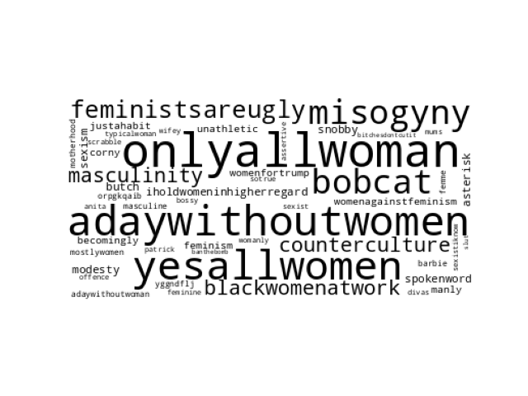
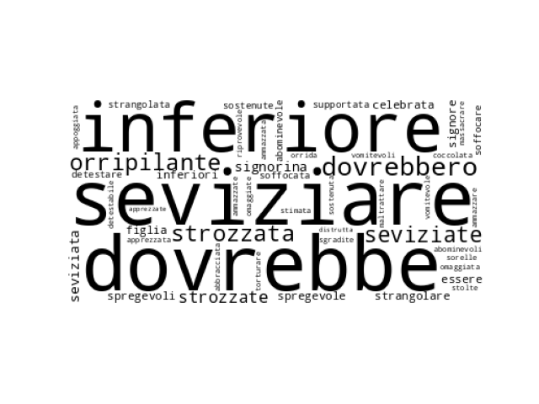
Language Comparison
06
Language has been compared using wordcloud, a graphical representation of the most frequent words in the dataset. The english dataset has gone through lemmatization to avoid repetition of words that pertain to the same lemma.
Italian Wordcloud
English Wordcloud

Slide 14
Conclusion
What was achieved?
What can be improved?
The analysis has followed through the data pre-processing, the model development and a language comparison.The main goal of the analysis, building a well-performing model, was achieved but better results would have been ideal.
Simpler models have proven to be totally useless, though more complex models have been to achieve results of nearly 70% in recall of the sexist class.
The biggest problem of the analysis was the low quality of the data. Firstly, the dataset was highly unbalanced and secondly, more important, the quality of the comments was so low that even more complex models struggling identifying information that could be useful to distinguish the two classes.

Slide 15

Thanks!

